Slide 1

Vishnu Waman Thakur Charitable Trust’s
VIVA INSTITUTE OF TECHNOLOGY
Shirgaon, Virar (East)
CryptoVault: Secure Password Keeper
NAME: Ms. Durga Adhikari Chhetri
ROLL NO: 1
CLASS: FYMCA
SEMESTER: II
GUIDED BY: Dr. Brijesh Joshi

Slide 2
INDEX
Introduction
Objectives
Scope
Existing System
Disadvantages Of Existing System
Proposed System
S/W Development Model
Software Requirement Specification
Technological Requirements
Modules Of The Project
Object Oriented Analysis & Design Diagram
I/O Screen Layout
Testing
Conclusion
Future Enhancements
References

Slide 3
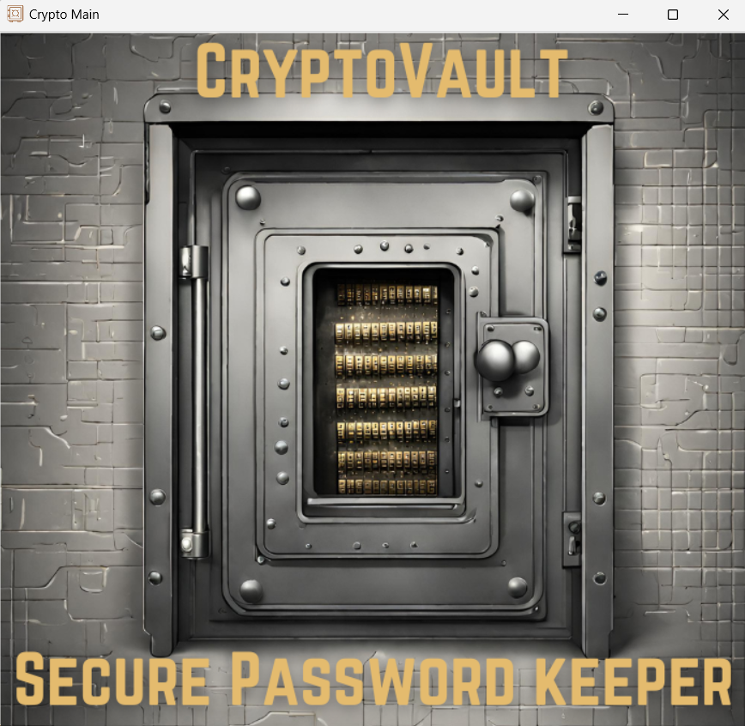
INTRODUCTION
CryptoVault addresses the need for secure password management in today's digital landscape.
Prioritizing security, CryptoVault encrypts stored passwords, making them nearly impossible to decipher without the decryption key.
CryptoVault offers a seamless and intuitive user experience, allowing easy navigation and password management.
CryptoVault is more than just a password management tool; it's a reliable companion for safeguarding digital identities.

Slide 4
OBJECTIVES
Secure Password Management
Data Encryption and Decryption
Intuitive User Interface
Password Retrieval and Display
Error Handling and Recovery
User Authentication

Slide 5
SCOPE
Develop a system for storing, retrieving, updating, and deleting passwords, along with encrypting passwords.
Implement strong encryption algorithms to secure sensitive data, ensuring secure decryption within the application.
Include mechanisms for user authentication, utilizing standard methods like username password authentication.
Design an intuitive interface for effortless interaction, ensuring usability for users of all levels.
Prioritize data security measures, adhering to best practices for encryption and authentication.
Provide ongoing maintenance, updates, and support to ensure system longevity and effectiveness.

Slide 6
SYSTEM STUDY AND PLANNING
Existing System
Existing password management systems vary widely in features and capabilities.
While they offer basic storage and autofill functions, they often lack robust security measures.
Some impose limitations on stored passwords or require payment for premium features.
This undermines user confidence in security and reliability.

Slide 7
DISADVANTAGES OF EXISTING SYSTEM
Security Vulnerabilities: Centralized server storage exposes user data to breaches, risking unauthorized access to sensitive information.
Lack of Privacy: Users may distrust third-party services with their passwords, questioning data handling and protection.
Premium Features: Access to advanced security features may require costly subscriptions, limiting user access.
Complexity: Complex interfaces and navigation hinder user adoption and intuitive usage.
Reliability Concerns: Users face system crashes and data loss, eroding trust in password management system effectiveness.

Slide 8
PROPOSED SYSTEM
CryptoVault securely stores and manages user passwords using encryption techniques to prevent unauthorized access.
Password data is stored locally on the device in CryptoVault, enhancing privacy and reducing reliance on external servers.
CryptoVault's user-friendly interface simplifies password management, allowing easy addition, viewing, and management of credentials.
CryptoVault includes encryption key management and secure decryption methods for robust password protection.
In CryptoVault, users can customize password entries and add additional information for flexible credential management.
Access to the password vault in CryptoVault is available even offline, ensuring uninterrupted credential availability.

Slide 9

S/W DEVELOPMENT MODEL
Agile Development Model
The Agile model suits the CryptoVault project by enabling adaptability to changes, focusing on user needs, and facilitating continuous improvements based on feedback.

Slide 10
SOFTWARE REQUIREMENT SPECIFICATION
Functional Requirements
Non-functional Requirements
CryptoVault enables user authentication, password management, and provides an intuitive interface with strong security features.
CryptoVault ensures high performance, robust security, reliability with backup mechanisms, usability with clear guidance, and compatibility across popular operating systems.

Slide 11
TECHNOLOGICAL REQUIREMENTS
Software / tools to be Used
Integrated Development Environment (IDE):
PyCharm
Programming Language:
Python
Database Management System (DBMS):
SQLite
Cryptography Library:
cryptography.fernet
Graphical User Interface:
Tkinter
Hardware to be Used
Computing Devices: Desktops or Laptops.
Memory and Storage: Adequate RAM and storage.

Slide 12
MODULES OF THE PROJECT
Account Creation
MainCrypto
Login
Password Keeper
Delete Password
CryptoVault
Store Password
Update Password
Search Password
View Password Details

Slide 13
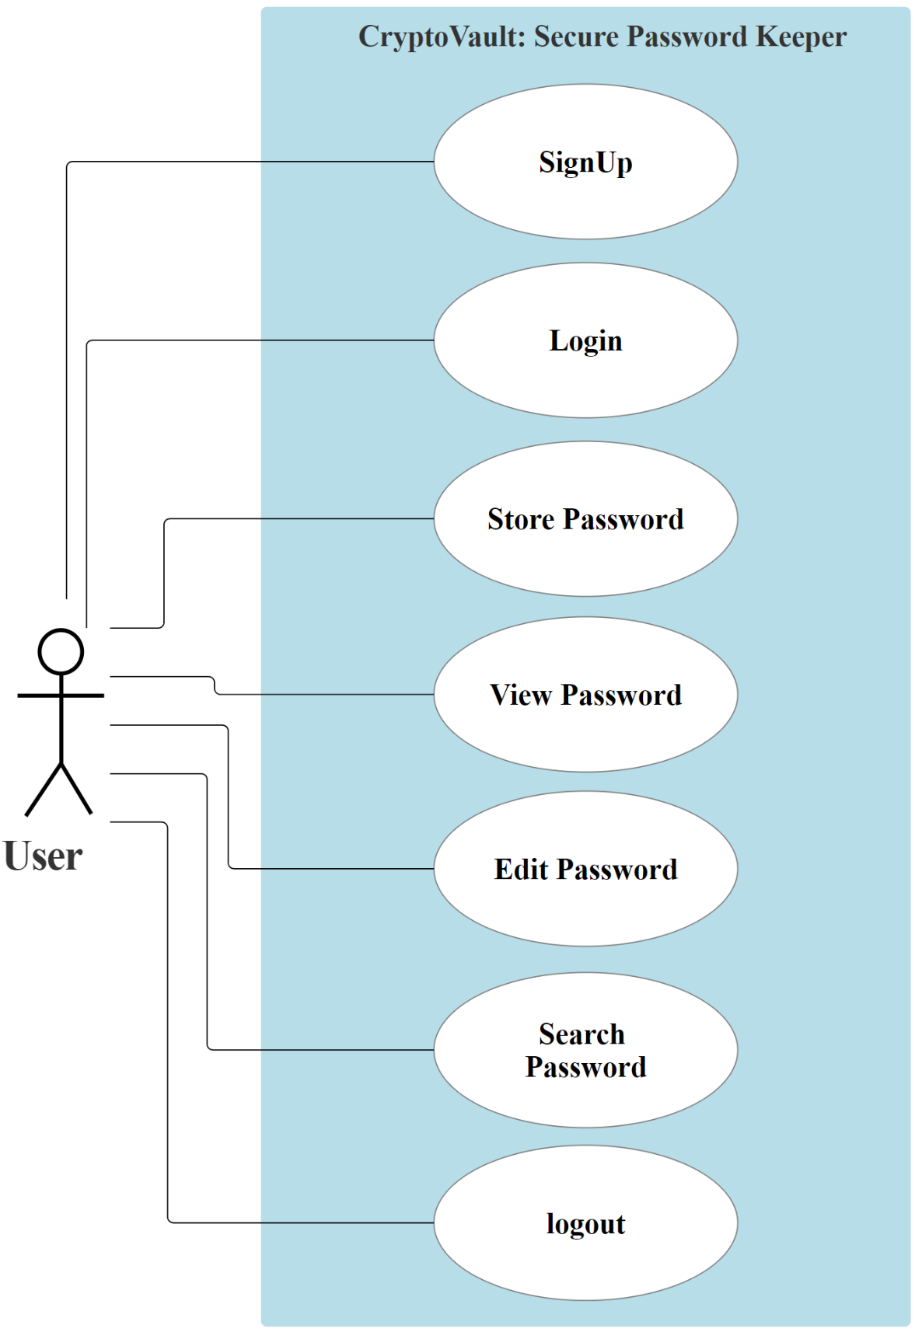
OBJECT ORIENTED ANALYSIS & DESIGN DIAGRAM
Use Case Diagram

Slide 14
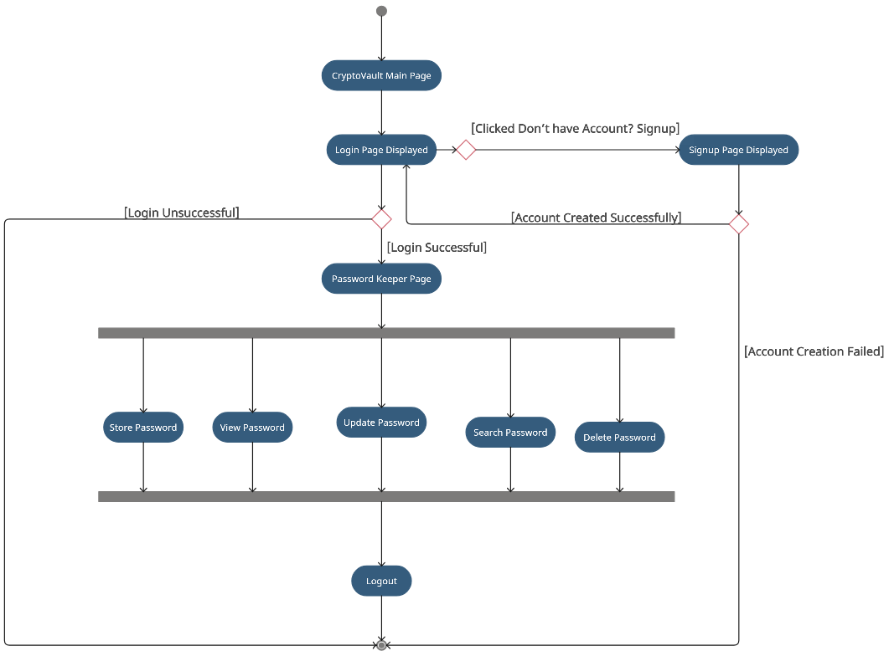
Activity Diagram

Slide 15
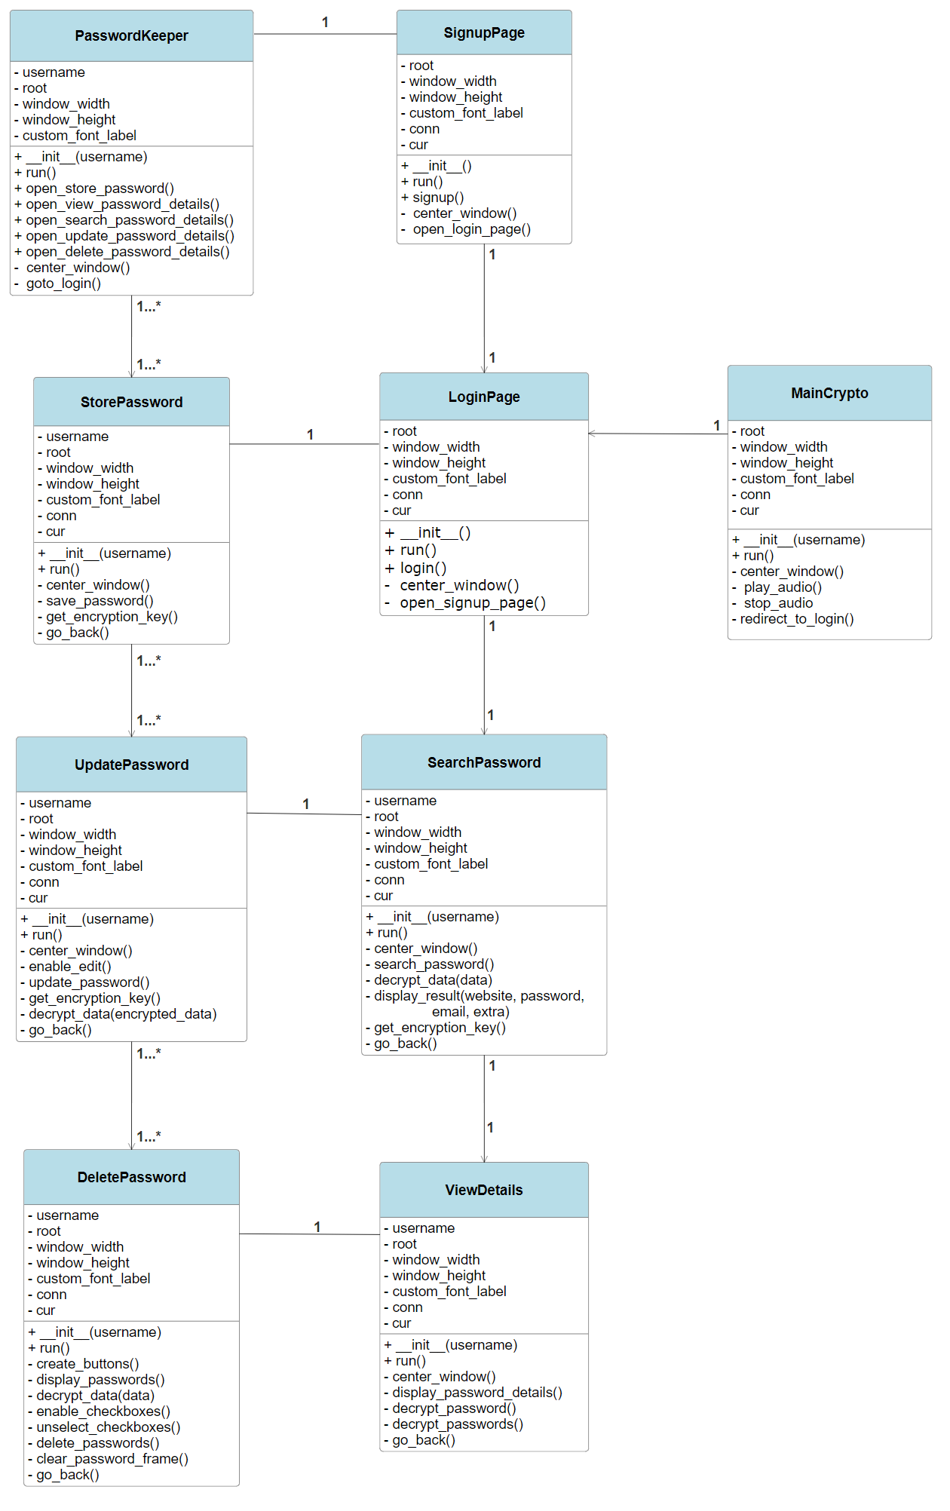
Class Diagram

Slide 16
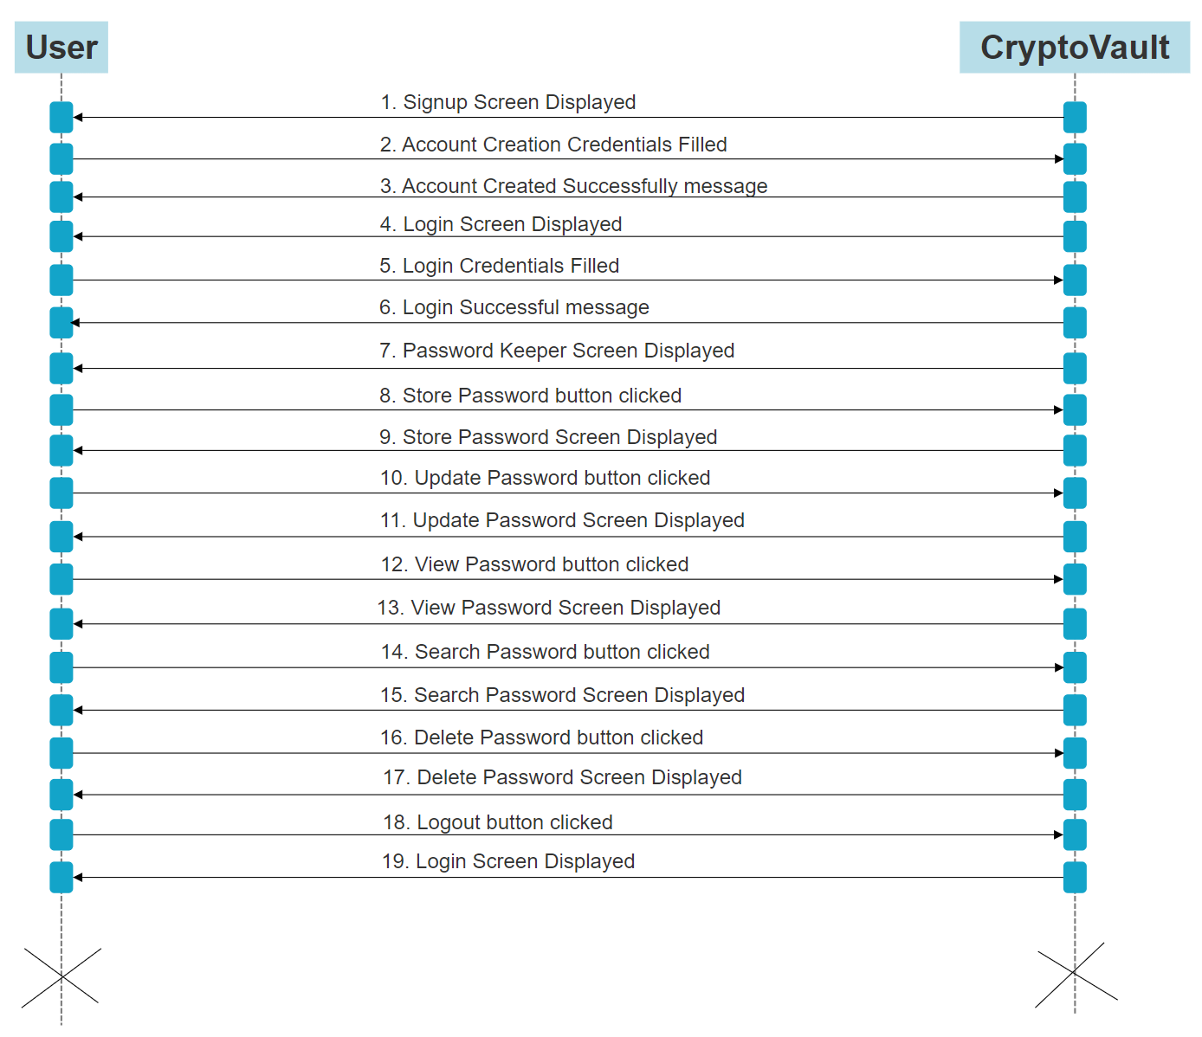
Sequence Diagram

Slide 17
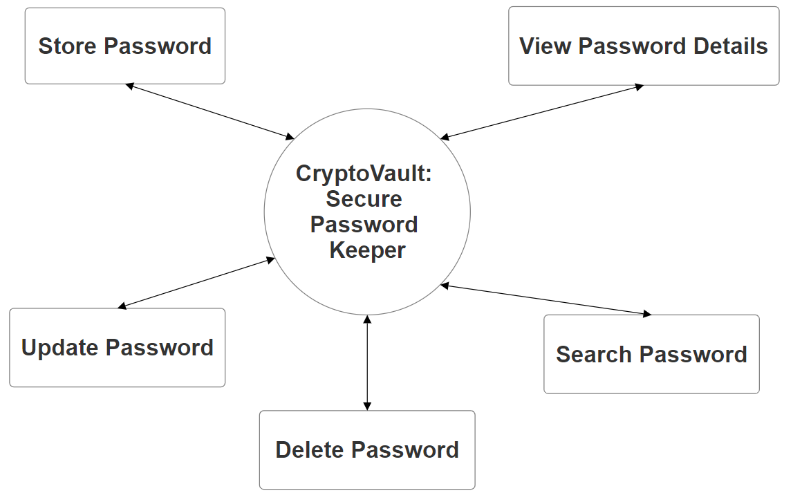
DFD Level 0 / Context Diagram

Slide 18
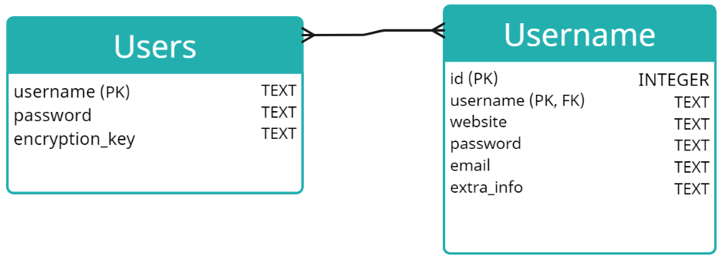
Database Table

Slide 19
I/O SCREEN LAYOUT
MainCrypto: This is the main entry point of CryptoVault application.

Slide 20
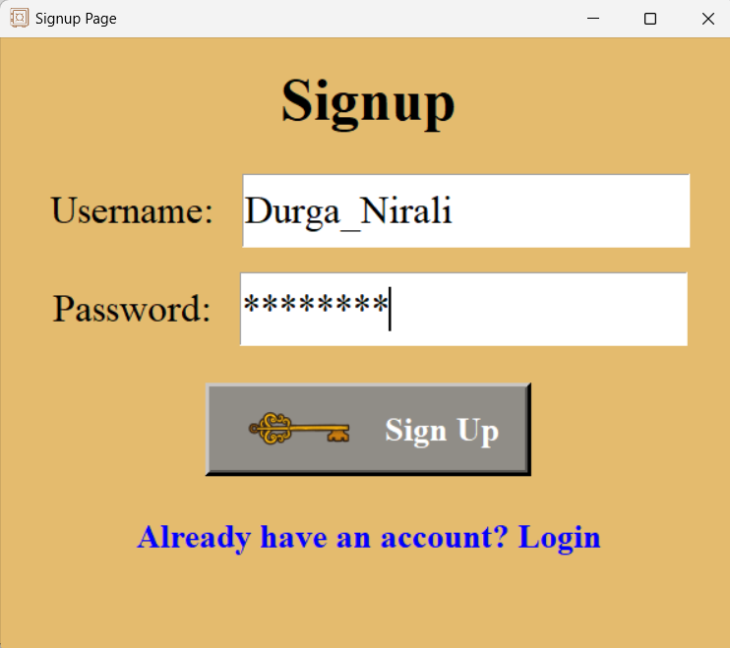
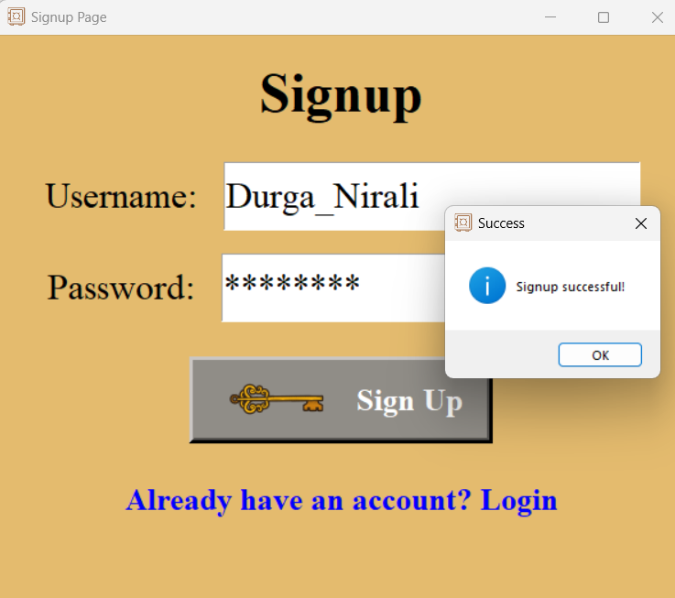
When the user clicks the "Sign Up" button, it checks if the username already exists in the database.
If the username is unique and both fields are non-empty, it generates an encryption key using the Fernet library and encrypts the password.
The encrypted password, along with the username and encryption key, is then inserted into the Users table in the database.
Finally, a success message is displayed, and the window is closed, redirecting the user to the login page.

Slide 21
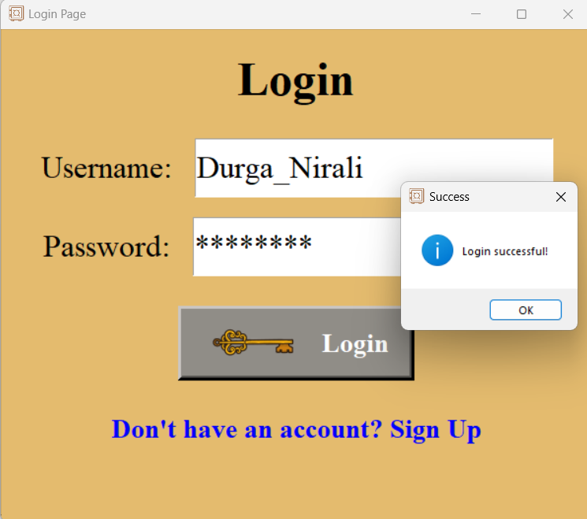
When the user enters their username and password and clicks the "Login" button, it retrieves the username and password entered by the user, validates them, and checks if the username exists in the database.
If the username exists, it decrypts the stored password using the encryption key associated with the username and compares it with the entered password. If the passwords match, a success message is displayed, and the window is closed, redirecting the user to the password keeper page.

Slide 22
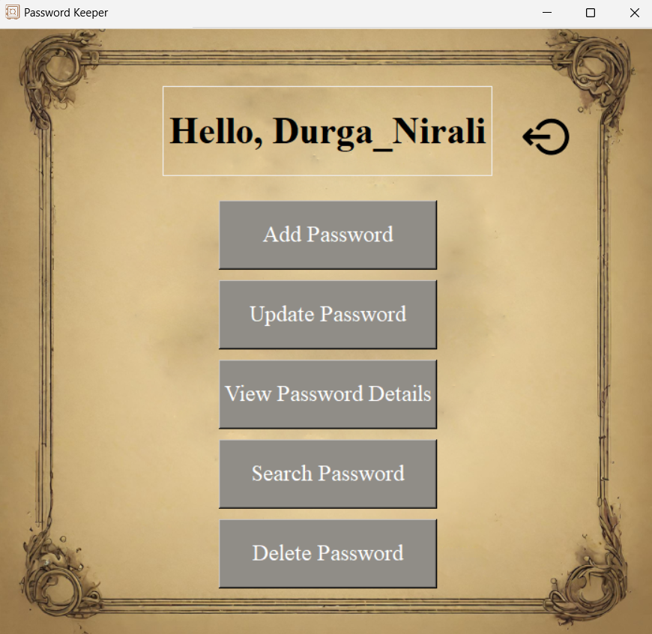
Password keeper page includes buttons for navigating to different functionalities, such as searching for passwords, adding new passwords, viewing password details, deleting passwords and logout button.

Slide 23
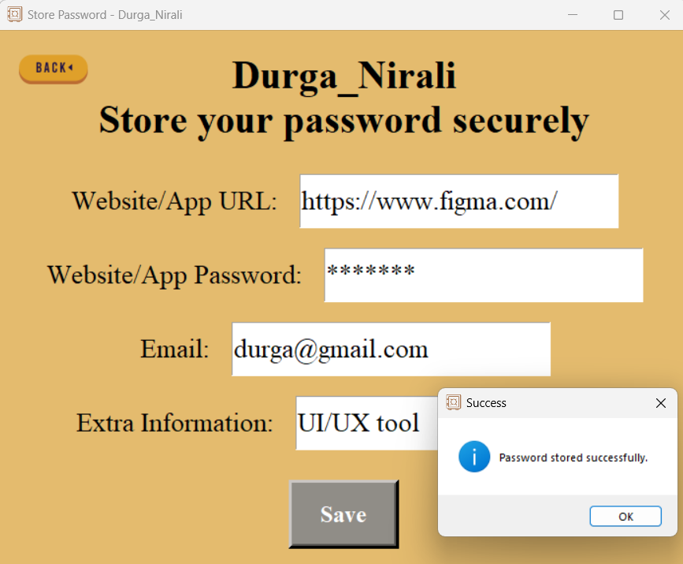
Upon clicking the "Save" button, it validates that essential fields. It then retrieves the encryption key associated with the user from the database and utilizes it to encrypt the password, website URL, email, and extra information. Subsequently, the encrypted data is inserted into the database table linked to the user. Upon successful storage, a confirmation message is displayed to the user

Slide 24
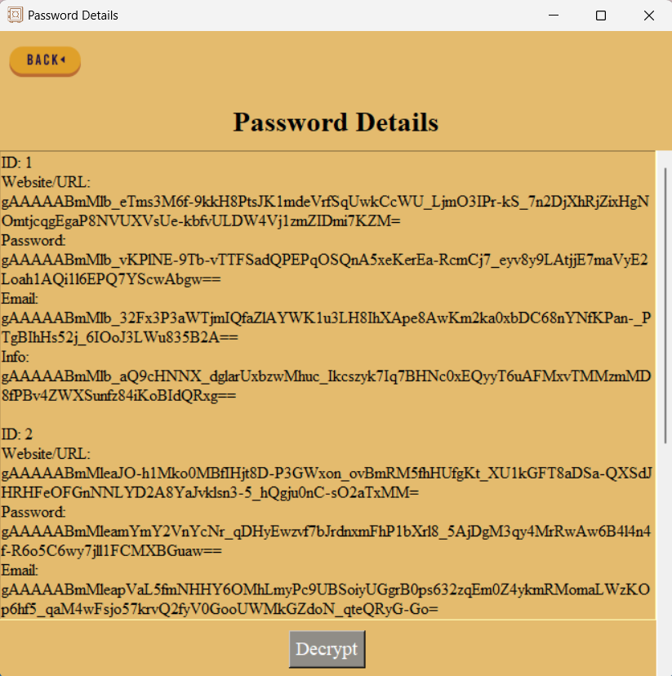
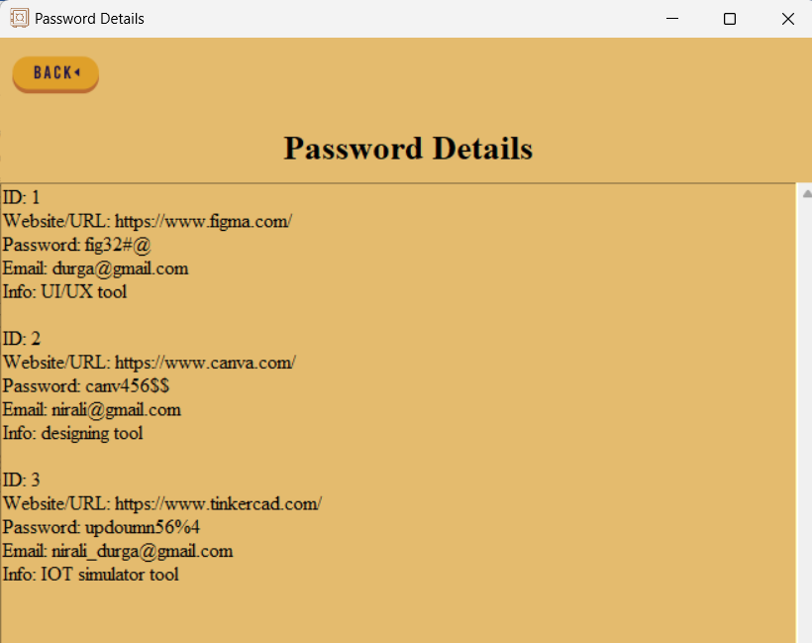
When view password details button is clicked the password details are displayed in encrypted form.
When user clicks the "Decrypt" button, it displays the decrypted password details.

Slide 25
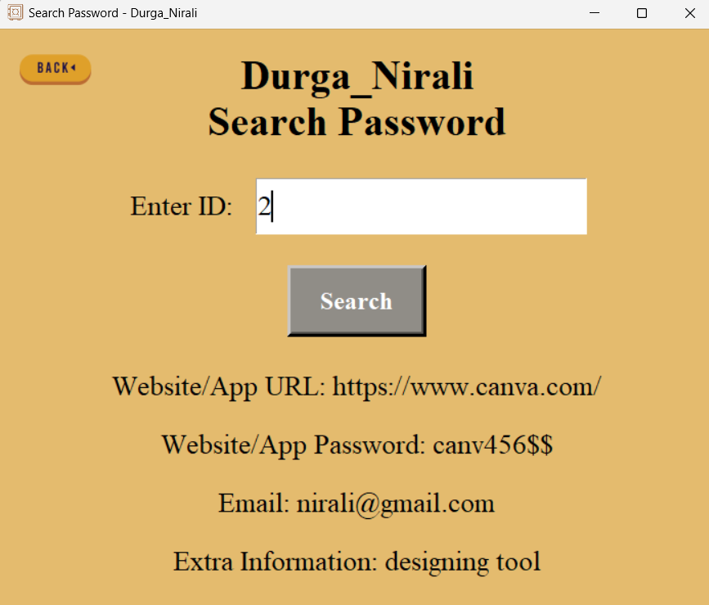
Users can search for specific passwords stored in their vault using ID. If a matching ID is found, it decrypts the encrypted data using the Fernet encryption key obtained from the database. The decrypted data is then displayed.

Slide 26
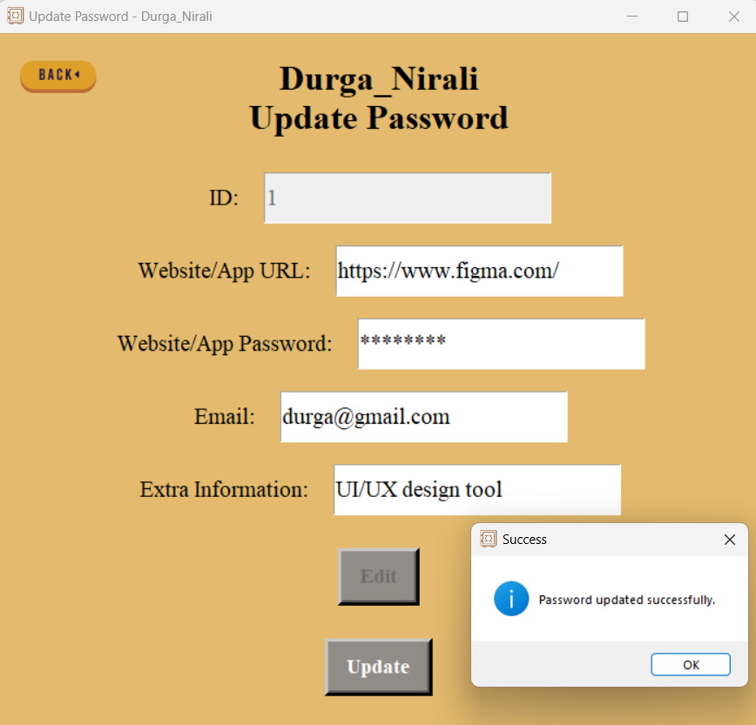
When User enters the ID and clicks the "Edit" button. It retrieves the ID entered by the user, disables the ID entry field, fetches the corresponding password details from the database, fills the entry fields with decrypted data, and enables them for editing.
User can then make changes and click the "Update" button. It retrieves the entered ID, website URL, password, email, and extra information, validates the fields, encrypts the data using the Fernet encryption key, updates the password entry in the database, and displays a success message. Finally, it disables the entry fields and the update button.

Slide 27
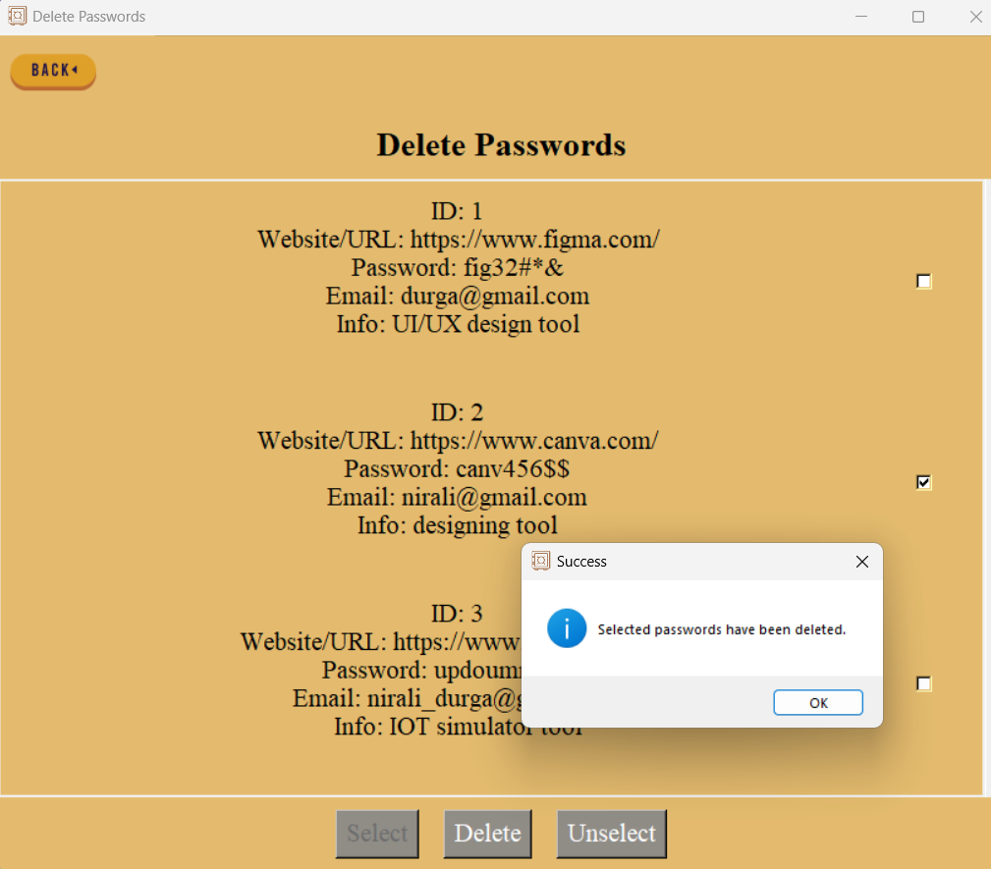
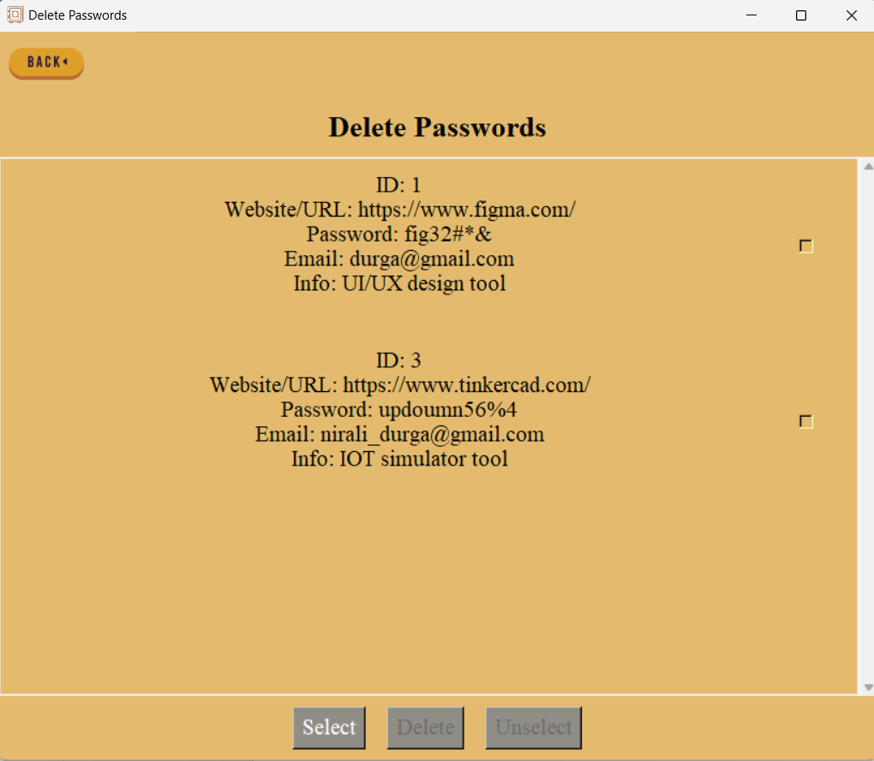
When User clicks on select button the checkboxes are enabled. User can select the checkboxes they want to delete and click on “Delete” button to delete it. User can select “Unselect” button to unselect selected checkboxes.

Slide 28
TESTING
Unit Testing
Integration Testing
System Testing
Types of Testing Performed
Usability Testing
Acceptance Testing
Regression Testing
Security Testing

Slide 29
CONCLUSION
CryptoVault stands as a testament to the commitment to security and usability, offering users a comprehensive solution to their password management needs.
With its robust features, rigorous testing, and dedication to user privacy, CryptoVault sets a high standard for password management applications, ensuring peace of mind for users in an increasingly digital world.

Slide 30
FUTURE ENHANCEMENTS
Biometric Authentication
Password Strength Analysis
Secure Sharing
Browser Integration
Cross-Platform Sync
Two-Factor Authentication (2FA)
Customizable Categories
Password Expiry Notifications
Import/Export Functionality
Password History

Slide 31
REFERENCES
pwdmgrBrowser.pdf (stanford.edu)
Design and Analysis of a Password Management System (ntnu.no)
Cryptography | March 2023 - Browse Articles (mdpi.com)
https://www.rfc-editor.org/rfc/rfc2898.html
https://csrc.nist.gov/publications/detail/sp/800-132/final
https://www.elcomsoft.com/WP/BH-EU-2012-WP.pdf
https://www.coursera.org/learn/crypto
cryptography-project · GitHub Topics · GitHub
https://www.sqlite.org/docs.html
https://docs.python.org/3/library/tkinter.html
https://cryptography.io/en/latest/

Slide 32
THANK YOU!!!

